Slide 1
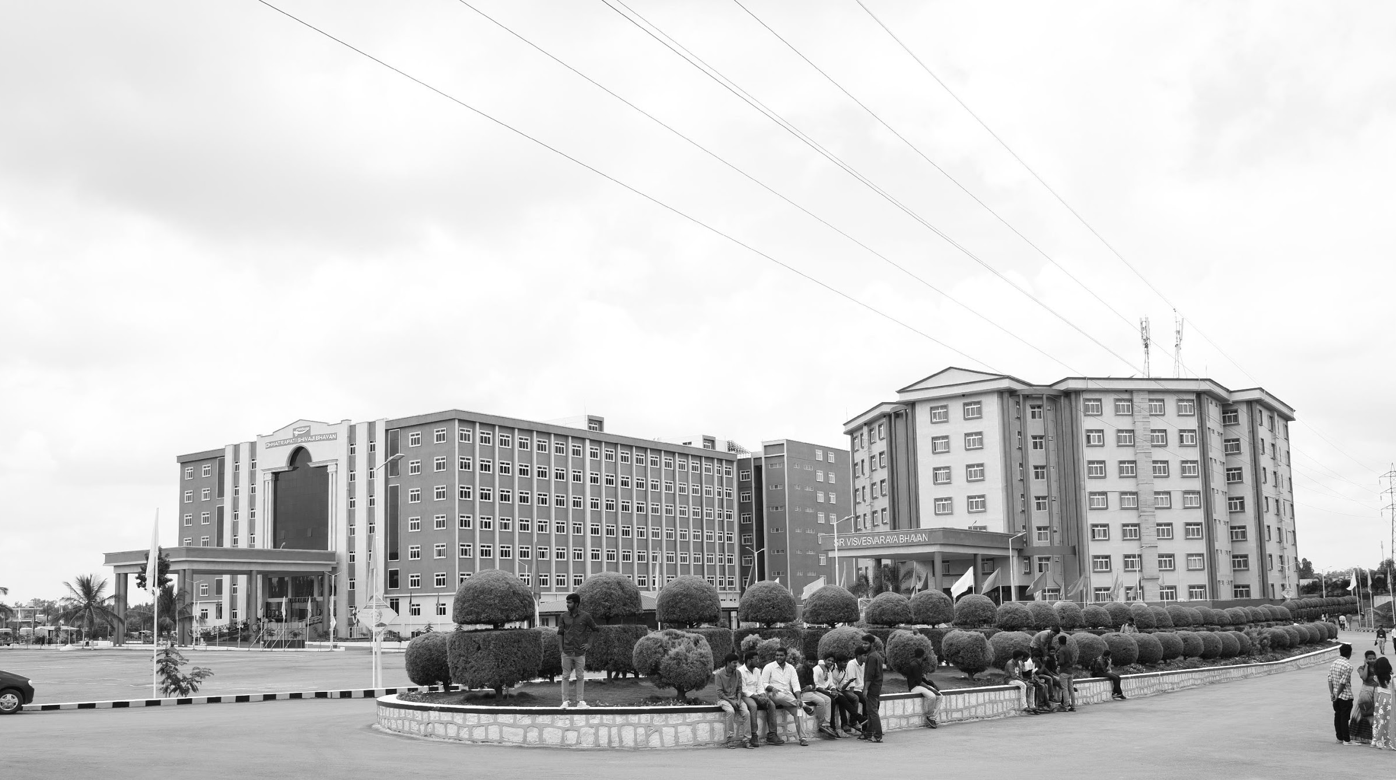

REAL-TIME HEALTH MONITORING SYSTEM FOR AUTOMOBILES
Final-Review 18/03/2025
Major Project
Project ID: V19
AY 2021-25
GITAM (Deemed-to-be) University
Department of Electrical Electronics and Communication Engineering
Project Team:
BU21EECE0100099 M LOKVIGNESH
BU21EECE0100475 K SOWMYA
BU21EECE0100160 R MOKSHITHA
Project Mentor:
S SIVARAJANI
Project In-charge:
DR PANKAJ KANDHWAY
www.gitam.edu

Slide 2
Objective and Goals
Objective
Condition Of Engine(parameters- temperature and humidity(in prototype)) or EV.
Improve Vehicle Reliability and Safety
Optimize Vehicle/Engine Performance and Efficiency
Reduce Maintenance Costs
Enhance Customer Satisfaction
Goals
Main Goals
Reduce breakdowns, increase uptime, enhance driver safety, and minimize accident risks.
Improve fuel efficiency, enhance engine performance, and reduce emissions.
Enable predictive maintenance, optimize maintenance schedules, and reduce overall costs.
Provide peace of mind, improve customer loyalty, and offer personalized maintenance recommendations.
Additional Goals
Provide features that allow owners to remotely monitor and control their vehicles
Incorporate technologies like autonomous emergency braking, lane departure warning, and blind spot monitoring.
Use eco-friendly materials in vehicle construction.
Offer personalized maintenance plans and services based on individual driving habits and preferences.

Slide 3
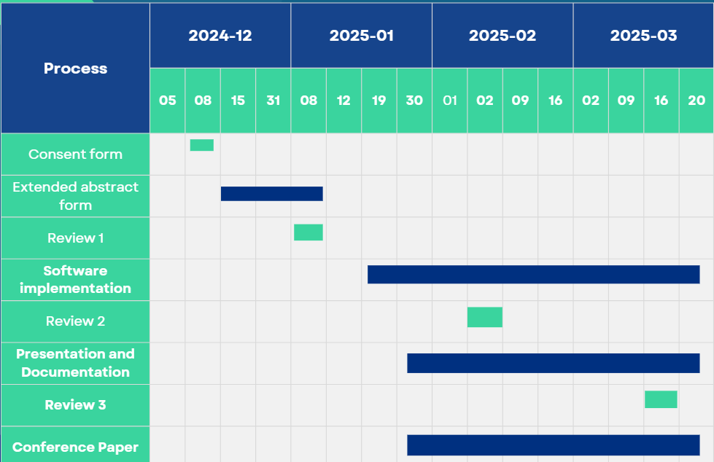
Project Plan

Slide 4
Literature Survey
Key Publications
Nithish Kanna J L Krishnakumar G, Muhammad Aadhil M, Dr. Ajay V P “Predictive Maintenance of Motors using Machine Learning”, Kumaraguru College of Technology.
H.E.G. Po~e and C.E. Fisher “Engine Health Monitoring: Towards Total Prognostics ”, United Kingdom.
Ryan Ahmed, Mohammed El Sayed, S. Andrew Gadsden, Jimi Tjong, and Saeid Habibi “Automotive Internal-Combustion-Engine Fault Detection and Classification Using Artificial Neural Network Techniques”, 2015.
Key Resources – Whitepaper| Application Notes | Datasheet| Others
Predictive Maintenance for Automotive
The Future of Automotive Health Monitoring
Application Note: Implementing a Real-Time Health Monitoring System for Electric Vehicles
IoT Gateway for Vehicle Health Data Collection
Existing Implementations – Products| Opensource| GitHub etc
Bosch Automotive
Continental
Vehicle Health Monitoring Platform (VHMP)
Predictive Maintenance for Automotive Engines
IoT-based Vehicle Health Monitoring

Slide 5
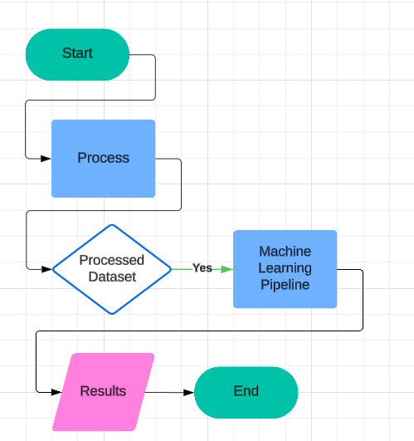
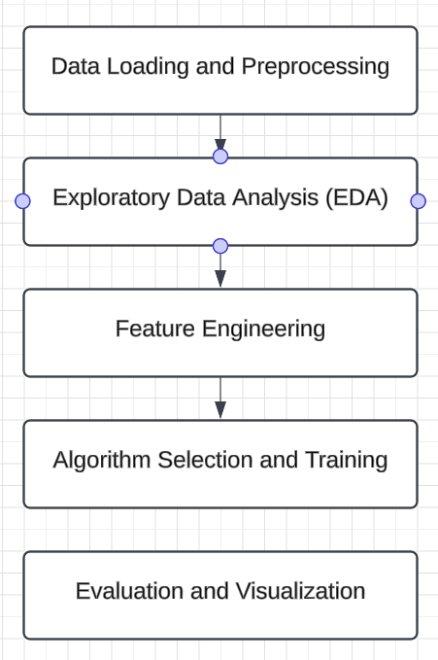
Architecture
Structural Diagram
Behaviour Diagram

Slide 6
Use Cases & Testing
Use Cases
Real-Time Temperature & Humidity Monitoring
Predictive Maintenance for Vehicle Health
Remote Vehicle Monitoring via Cloud
Anomaly Detection Using AI Models
Data-Driven Decision Making for Auto Maintenance
Test Cases
Sensor Data Collection
Wokwi Simulation
MQTT Data Transmission
Node-RED Data Processing
Cloud Database Storage
Anomaly Detection
Dashboard Real-Time Update
Predictive Maintenance

Slide 7

Implementation and Results – Iteration 1
#include <WiFi.h>
#include <PubSubClient.h>
#include <DHTesp.h>
const int DHT_PIN = 15;
DHTesp dht;
const char* ssid = "Wokwi-GUEST";
const char* password = "";
const char* mqtt_server = "test.mosquitto.org";
WiFiClient espClient;
PubSubClient client(espClient);
unsigned long lastMsg = 0;
float temp = 0;
float hum = 0;
void setup_wifi() {
delay(10);
Serial.println();
Serial.print("Connecting to ");
Serial.println(ssid);

Slide 8
Implementation and Results - CODE
WiFi.mode(WIFI_STA);
WiFi.begin(ssid, password);
while (WiFi.status() != WL_CONNECTED) {
delay(500);
Serial.print(".");
}
randomSeed(micros());
Serial.println("");
Serial.println("WiFi connected");
Serial.println("IP address: ");
Serial.println(WiFi.localIP());
}
void callback(char* topic, byte* payload, unsigned int length) {
Serial.print("Message arrived [");
Serial.print(topic);
Serial.print("] ");
for (int i = 0; i < length; i++) {
Serial.print((char)payload[i]);
}}

Slide 9
Implementation and Results - CODE
void reconnect() {
while (!client.connected()) {
Serial.print("Attempting MQTT connection...");
String clientId = "ESP32Client-";
clientId += String(random(0xffff), HEX);
if (client.connect(clientId.c_str())) {
Serial.println("Connected");
client.publish("/ThinkIOT/Publish", "Welcome");
client.subscribe("/ThinkIOT/Subscribe");
} else {
Serial.print("failed, rc=");
Serial.print(client.state());
Serial.println(" try again in 5 seconds");
delay(5000);
}}
}
void setup() {
pinMode(2, OUTPUT);
Serial.begin(115200);
setup_wifi();
client.setServer(mqtt_server, 1883);
client.setCallback(callback);
dht.setup(DHT_PIN, DHTesp::DHT22);
}

Slide 10
Implementation and Results - CODE
void loop() {
if (!client.connected()) {
reconnect();
}
client.loop();
unsigned long now = millis();
if (now - lastMsg > 2000) { //perintah publish data
lastMsg = now;
TempAndHumidity data = dht.getTempAndHumidity();
String temp = String(data.temperature, 2);
client.publish("/Thinkitive/temp", temp.c_str());
String hum = String(data.humidity, 1);
client.publish("/Thinkitive/hum", hum.c_str());
Serial.print("Temperature: ");
Serial.println(temp);
Serial.print("Humidity: ");
Serial.println(hum);
}
}

Slide 11
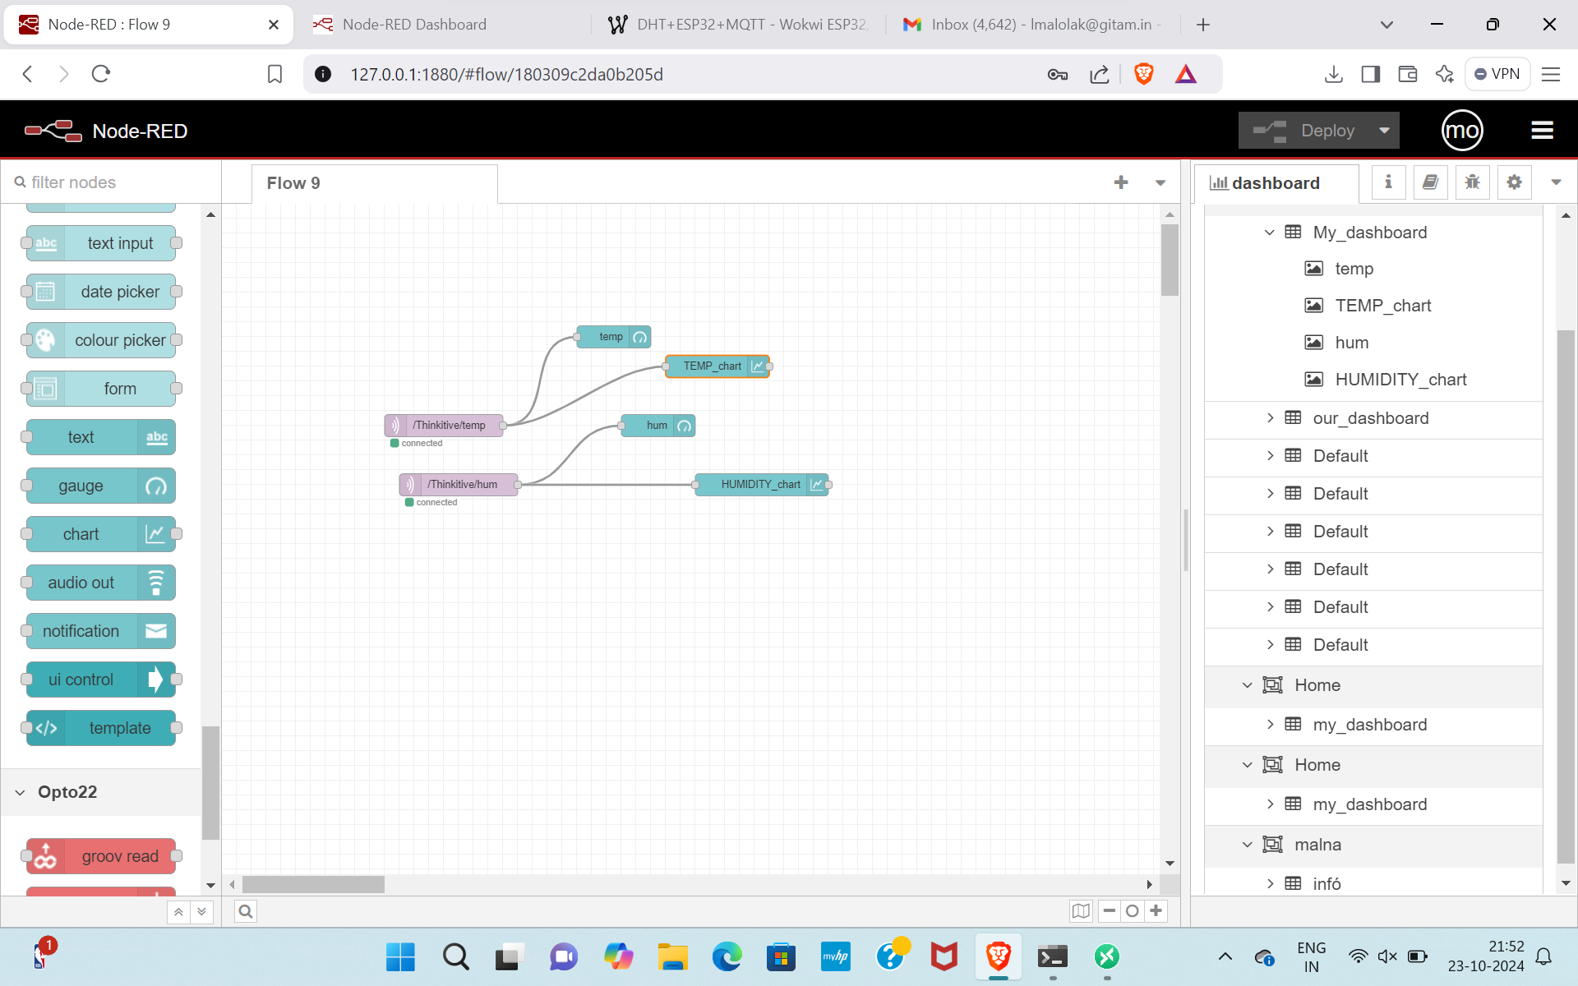
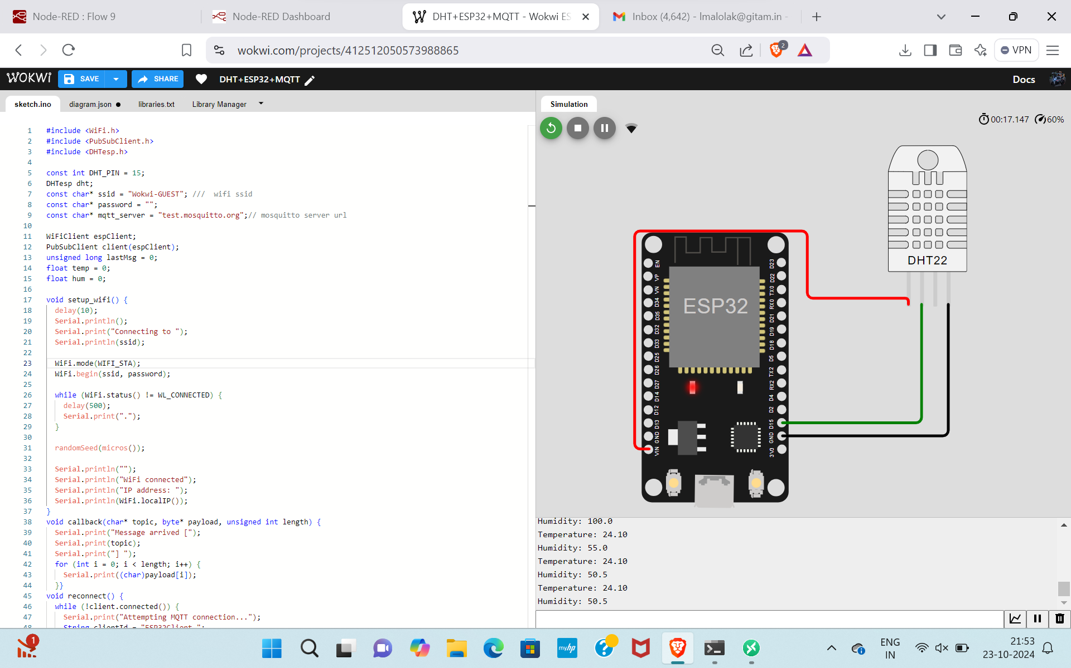
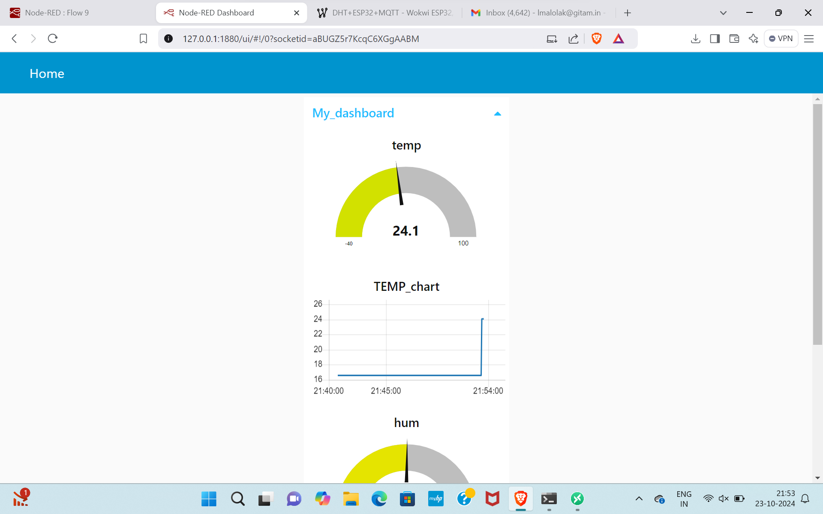
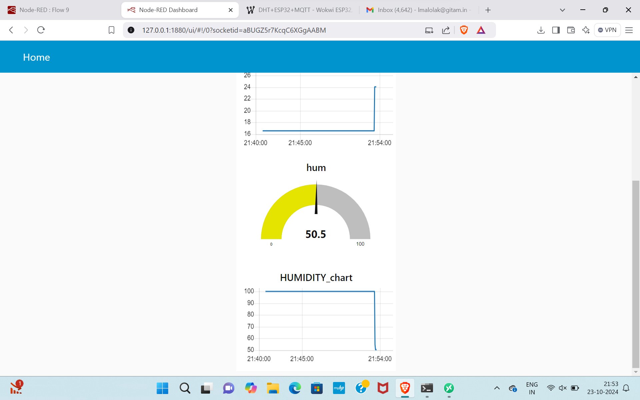
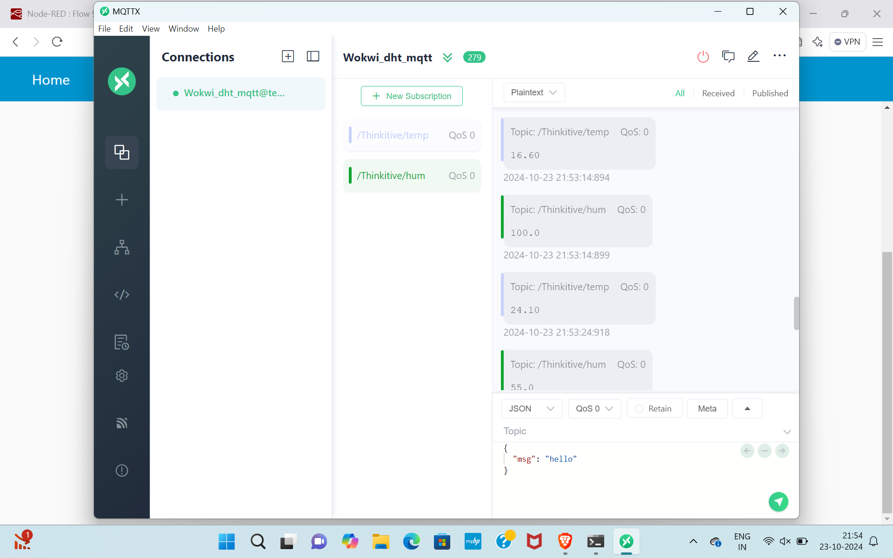
Implementation and Results – Iteration 1
Iteration 1 : Results

Slide 12
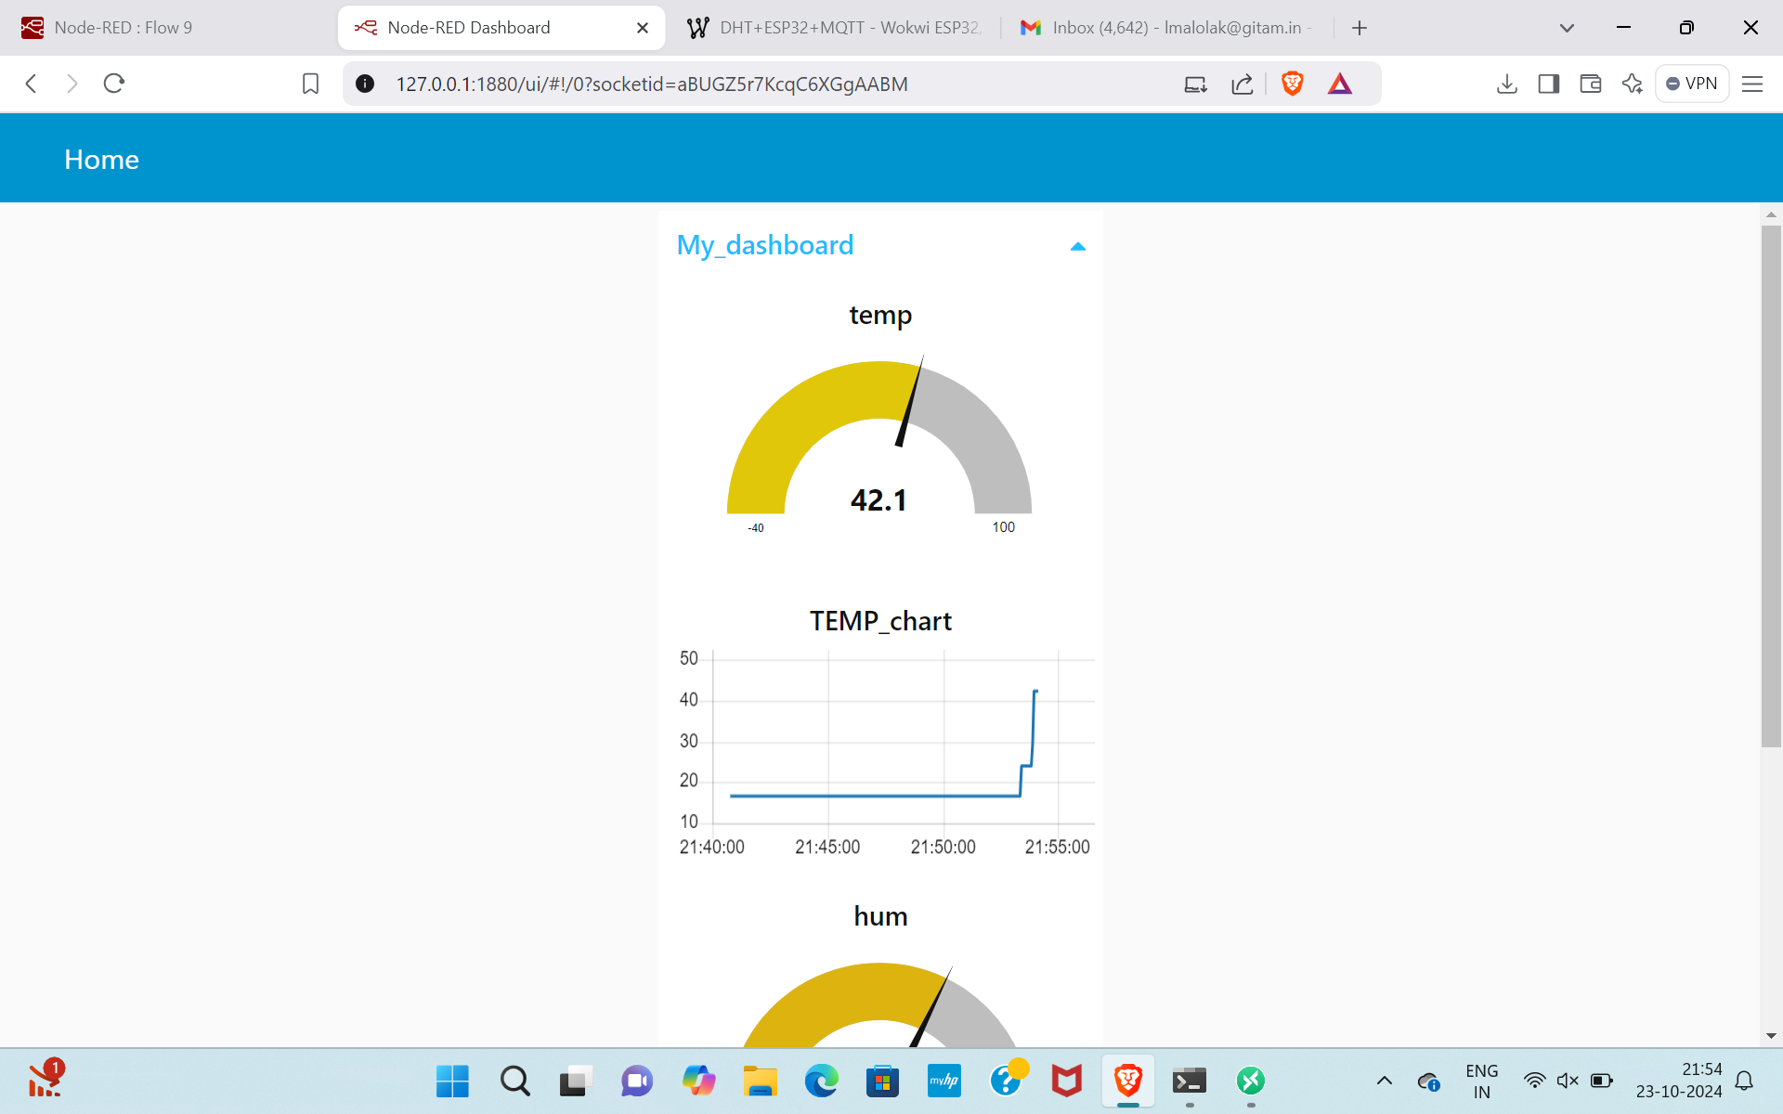
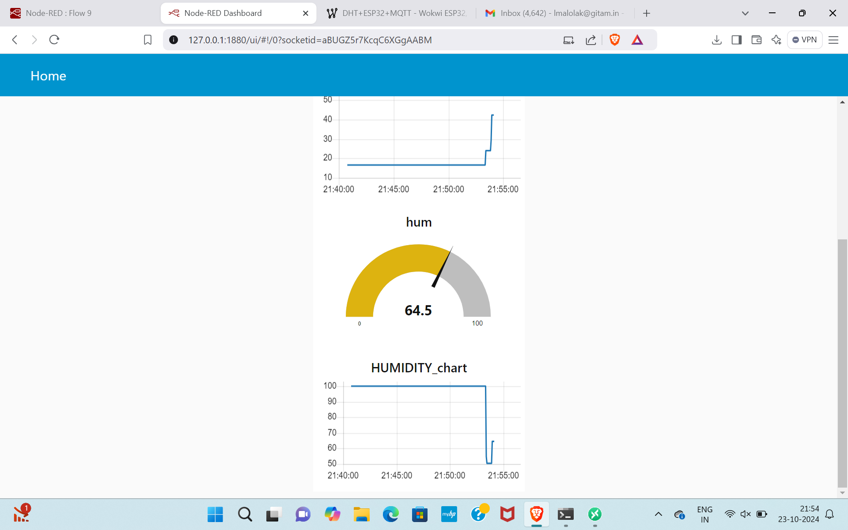

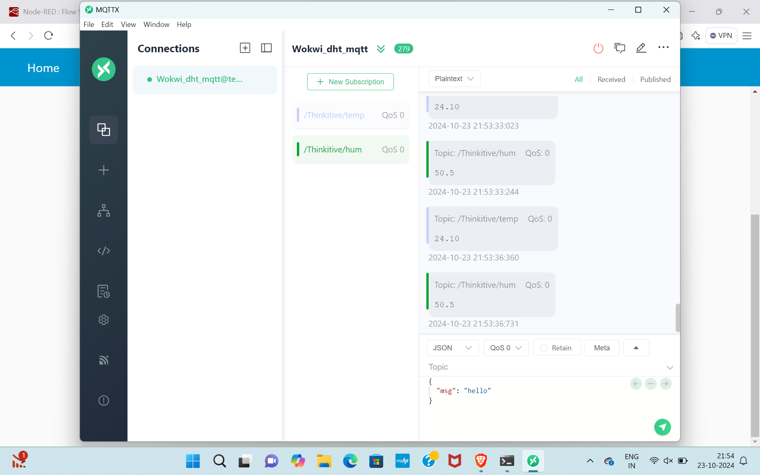
Implementation and Results – Iteration 2
Iteration : Results + Validation against the usecases and test cases

Slide 13

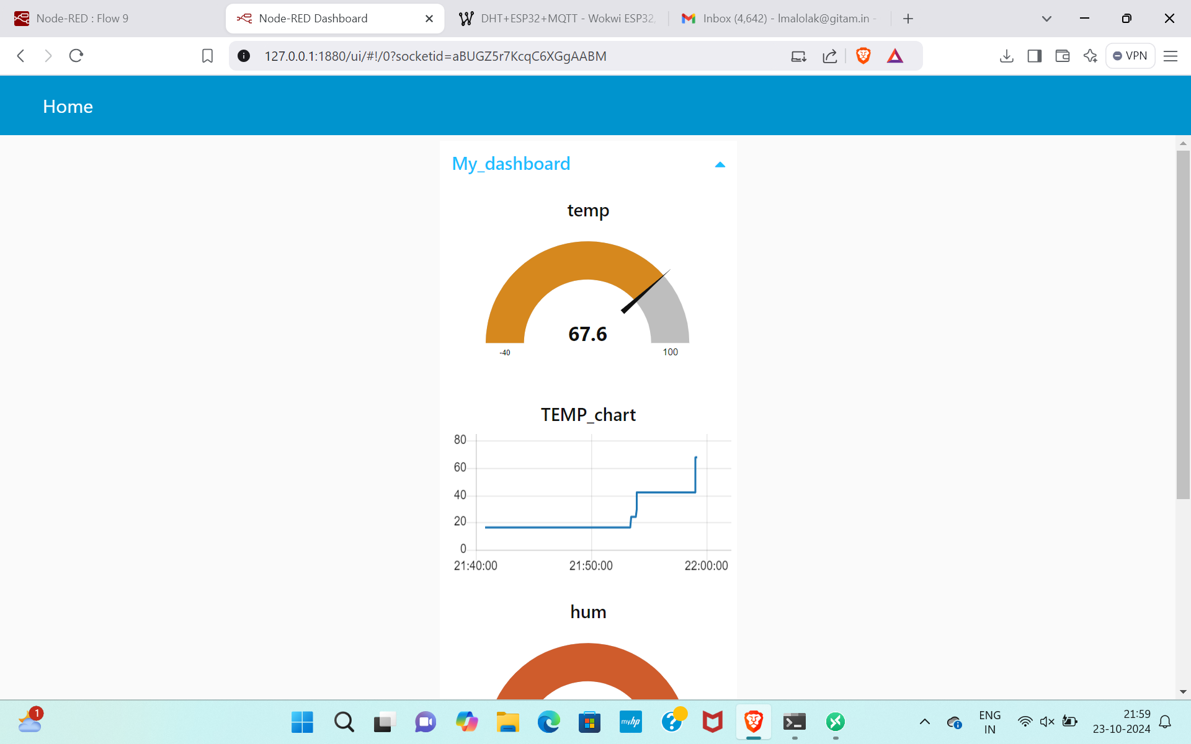
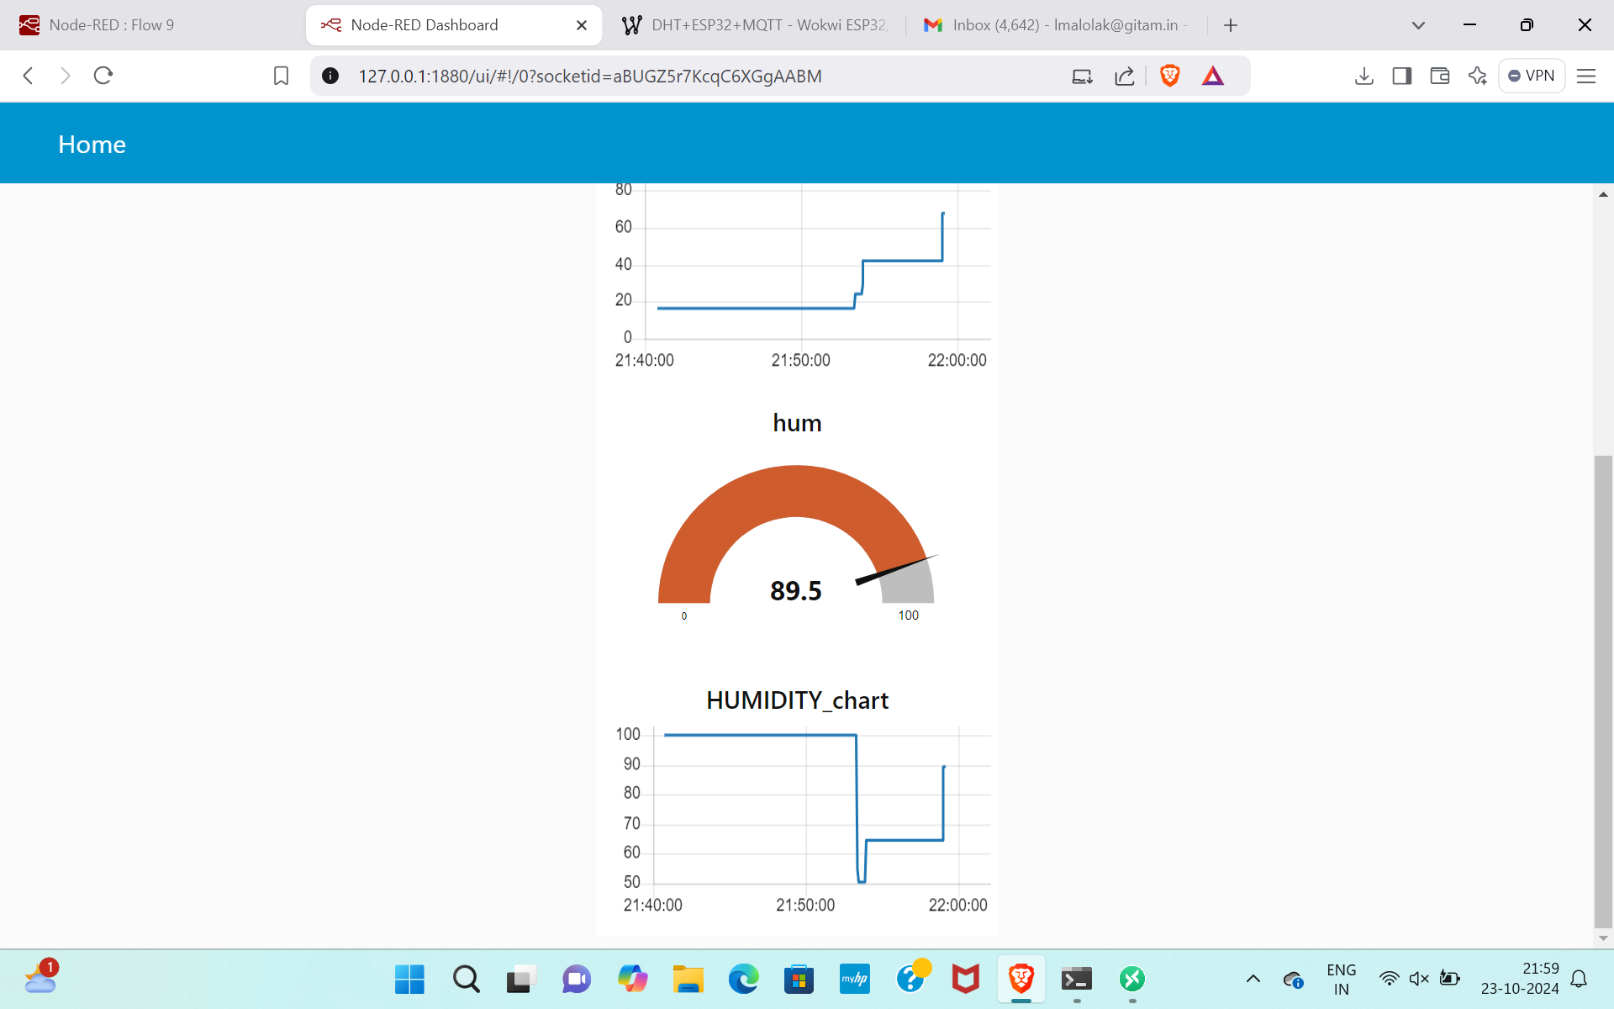
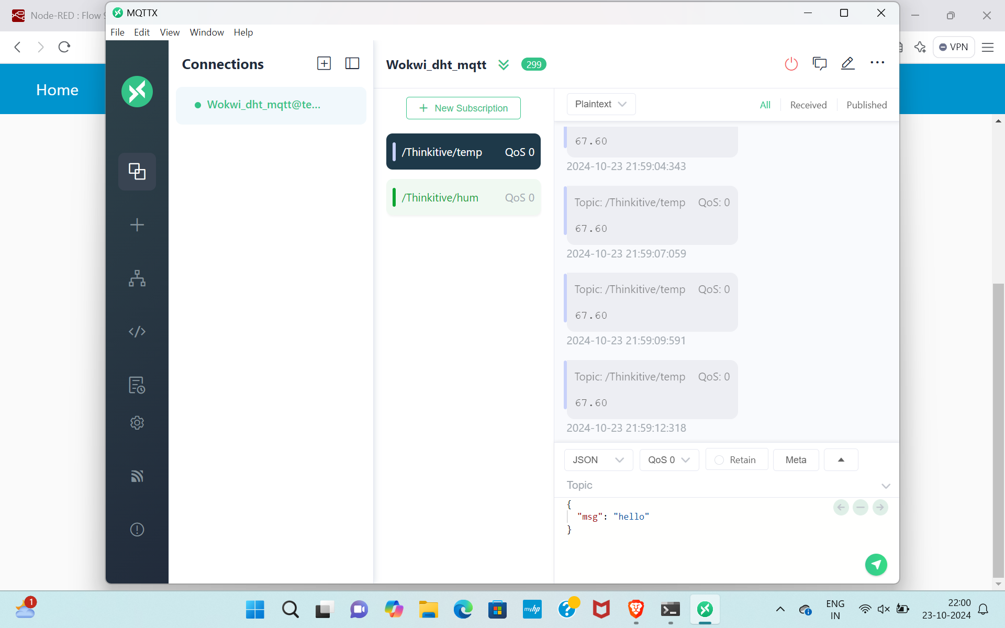
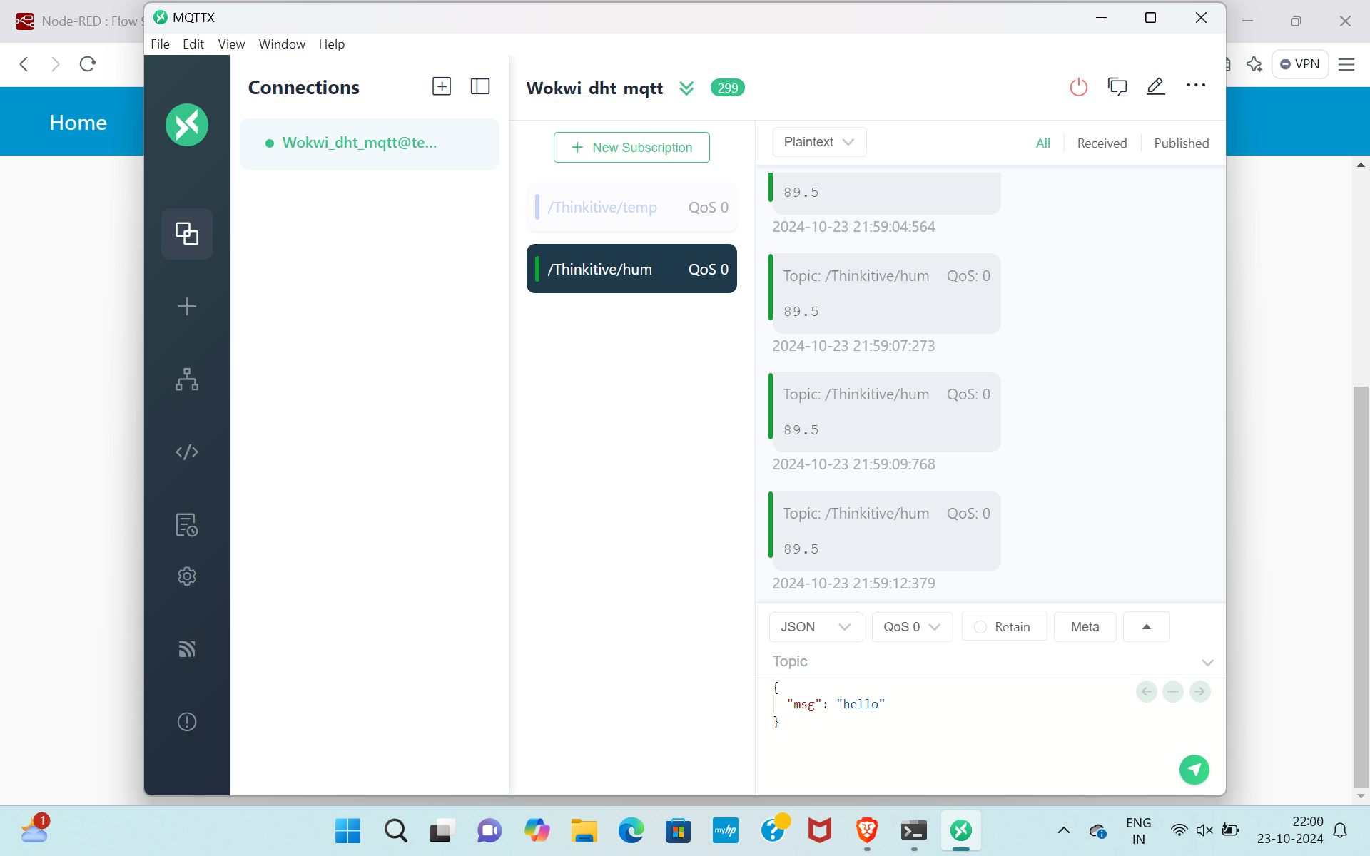
Implementation and Results – Iteration 3 (Optional)
Iteration : Results + Validation against the usecases and test cases

Slide 14
Implementation and Results – CODE
Results(sending temperature and humidity values to thingspeak)
#include <WiFi.h>
#include "DHTesp.h"
#include "ThingSpeak.h"
const int DHT_PIN = 15;
const int LED_PIN = 13;
const char* WIFI_NAME = "Wokwi-GUEST";
const char* WIFI_PASSWORD = "";
const int myChannelNumber =2866225 ;
const char* myApiKey = "TO8PY8HLI21L887U";
const char* server = "api.thingspeak.com";
DHTesp dhtSensor;
WiFiClient client;
void setup() {
Serial.begin(115200);
dhtSensor.setup(DHT_PIN, DHTesp::DHT22);
pinMode(LED_PIN, OUTPUT);
WiFi.begin(WIFI_NAME, WIFI_PASSWORD);
while (WiFi.status() != WL_CONNECTED){
delay(1000);
Serial.println("Wifi not connected");
}

Slide 15
Implementation and Results – CODE
Serial.println("Wifi connected !");
Serial.println("Local IP: " + String(WiFi.localIP()));
WiFi.mode(WIFI_STA);
ThingSpeak.begin(client);
}
void loop() {
TempAndHumidity data = dhtSensor.getTempAndHumidity();
ThingSpeak.setField(1,data.temperature);
ThingSpeak.setField(2,data.humidity);
if (data.temperature > 35 || data.temperature < 12 || data.humidity > 70 || data.humidity < 40) {
digitalWrite(LED_PIN, HIGH);
}else{
digitalWrite(LED_PIN, LOW);
}
int x = ThingSpeak.writeFields(myChannelNumber,myApiKey);
Serial.println("Temp: " + String(data.temperature, 2) + "°C");
Serial.println("Humidity: " + String(data.humidity, 1) + "%");
if(x == 200){
Serial.println("Data pushed successfull");
}else{
Serial.println("Push error" + String(x));
}
Serial.println("---");
delay(10000);
}

Slide 16
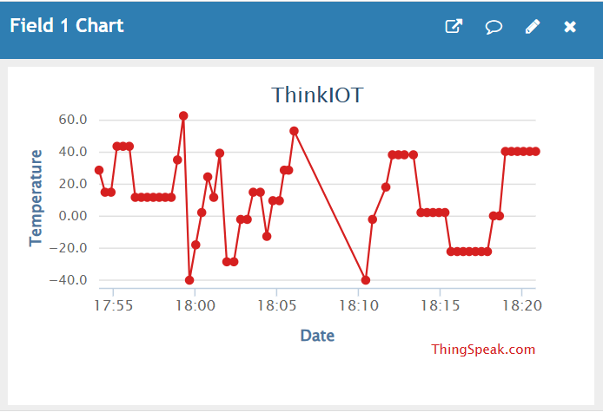
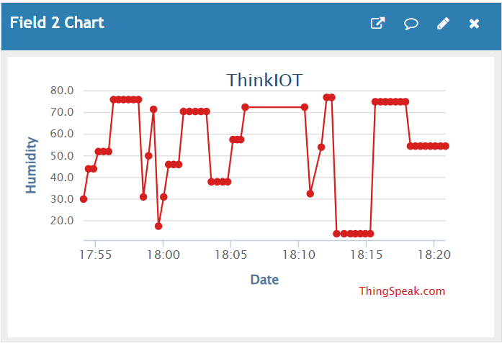
Implementation and Results – Iteration 1
Results(Temperature and humidity data points)
16

Slide 17
Implementation and Results – CODE
Results(Analysing the data points)
tempData = data(:, 1);
humidityData = data(:, 2);
if isempty(tempData) || isempty(humidityData)
disp('No data available for analysis.');
return;
end
tempMean = mean(tempData);
tempMedian = median(tempData);
tempMax = max(tempData);
tempMin = min(tempData);
tempStd = std(tempData);
humidityMean = mean(humidityData);
humidityMedian = median(humidityData);
humidityMax = max(humidityData);
humidityMin = min(humidityData);
humidityStd = std(humidityData); disp(['Standard Deviation: ', num2str(humidityStd)]);
disp('Temperature Data Analysis:');
disp(['Mean: ', num2str(tempMean)]);
disp(['Median: ', num2str(tempMedian)]);
disp(['Maximum: ', num2str(tempMax)]);
disp(['Minimum: ', num2str(tempMin)]);
disp(['Standard Deviation: ', num2str(tempStd)]);
disp(' ');

Slide 18
Implementation and Results – CODE
Results(Analysing the data points)
disp('Humidity Data Analysis:');
disp(['Mean: ', num2str(humidityMean)]);
disp(['Median: ', num2str(humidityMedian)]);
disp(['Maximum: ', num2str(humidityMax)]);
disp(['Minimum: ', num2str(humidityMin)]);

Slide 19
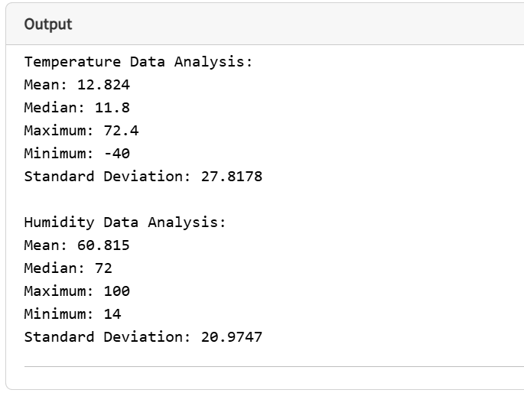
Implementation and Results – Iteration 1
Results
19

Slide 20
Implementation and Results – CODE
Results(K- means clustering)
clc; clear;
channelID = 2866225;
apiKey = 'NP9UV091MIBOZIB4';
[data, timeStamps] = thingSpeakRead(channelID, 'Fields', [1, 2], 'ReadKey', apiKey, 'NumPoints', 100);
temperature = data(:, 1);
humidity = data(:, 2);
numSamples = length(temperature);
if isempty(temperature) || isempty(humidity)
disp('No data available for analysis.');
return;
end
sampleIndices = (1:numSamples)';
mdl_temp = fitlm(sampleIndices, temperature);
mdl_hum = fitlm(sampleIndices, humidity);
future_samples = (max(sampleIndices) + 1):(max(sampleIndices) + 10);
pred_temp = predict(mdl_temp, future_samples');
pred_hum = predict(mdl_hum, future_samples');
labels = zeros(numSamples, 1);
for i = 1:numSamples
if (temperature(i) > 40) || (humidity(i) > 80)
labels(i) = 1;
end
end

Slide 21
Implementation and Results – CODE
Results(K- means clustering)
predictedLabels = labels;
accuracy = sum(predictedLabels == labels) / numSamples * 100;
features = [temperature, humidity];
numClusters = 2;
[idx, centers] = kmeans(features, numClusters);
figure;
scatter3(temperature, humidity, sampleIndices, 50, idx, 'filled');
hold on;
scatter3(centers(:,1), centers(:,2), max(sampleIndices) + 5 * ones(numClusters, 1), 100, 'kx', 'LineWidth', 2);
xlabel('Temperature (°C)');
ylabel('Humidity (%)');
zlabel('Sample Index');
title('K-Means Clustering on Temperature and Humidity Data');
legend('Data Points', 'Cluster Centers');
grid on;
hold off;
disp('Temperature Data Analysis:');
disp(['Mean: ', num2str(mean(temperature))]);
disp(['Max: ', num2str(max(temperature))]);
disp(['Min: ', num2str(min(temperature))]);
disp(['Standard Deviation: ', num2str(std(temperature))]);
disp(' ');

Slide 22
Implementation and Results – CODE
Results(K- means clustering)
disp('Humidity Data Analysis:');
disp(['Mean: ', num2str(mean(humidity))]);
disp(['Max: ', num2str(max(humidity))]);
disp(['Min: ', num2str(min(humidity))]);
disp(['Standard Deviation: ', num2str(std(humidity))]);
disp(' ');
disp(['Classification Accuracy (Safe vs. Unsafe): ', num2str(accuracy), '%']);
disp('K-Means Clustering completed successfully!');

Slide 23
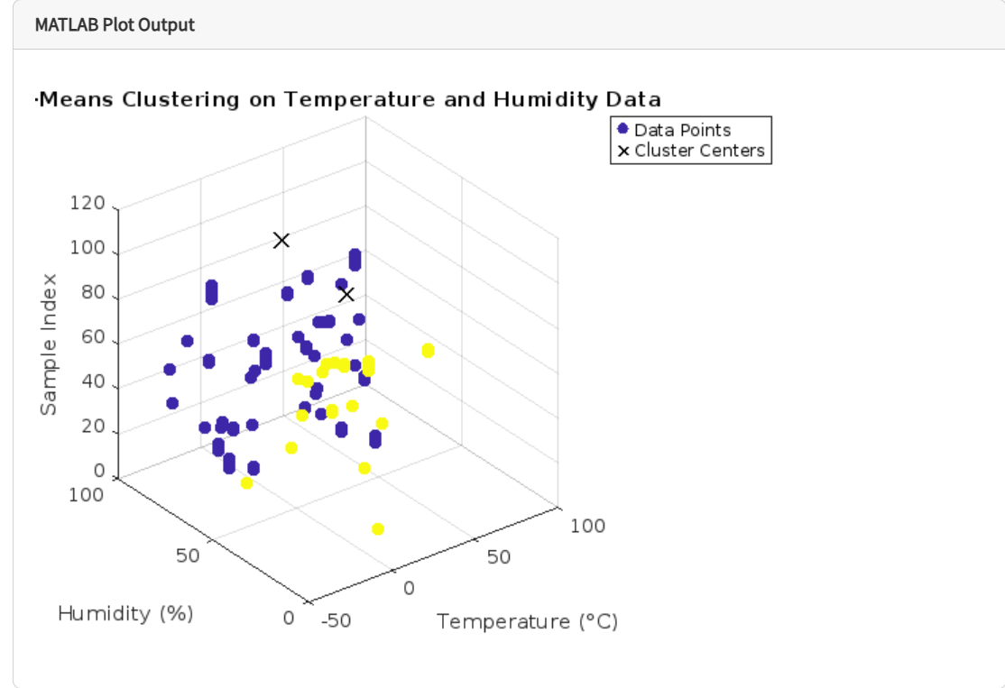
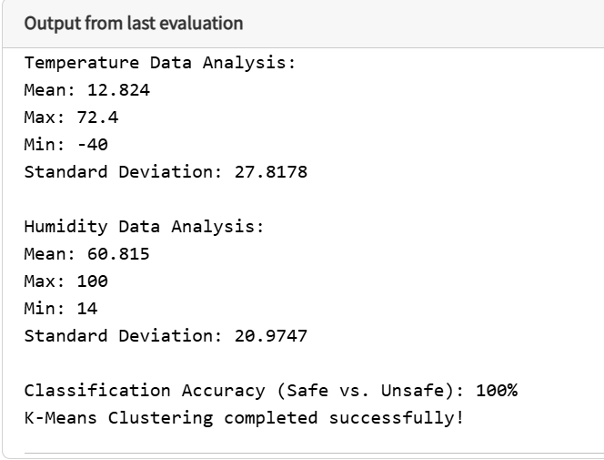
Implementation and Results – Iteration 1
Results
23

Slide 24
Implementation and Results – CODE
Results(Prediction of Temperature)
clc; clear;
channelID = 2866225;
apiKey = 'NP9UV091MIBOZIB4';
[data, timeStamps] = thingSpeakRead(channelID, 'Fields', 1, 'ReadKey', apiKey, 'NumPoints', 300);
temperature = data(:, 1);
numSamples = length(temperature);
if isempty(temperature)
disp('No temperature data available for analysis.');
return;
end
temp_mean = mean(temperature);
temp_range = range(temperature);
norm_temperature = (temperature - temp_mean) / temp_range;
smoothed_temperature = movmean(norm_temperature, 5);
sampleIndices = (1:numSamples)';
ft = fittype('a*sin(b*x + c) + d*cos(e*x + f) + g*x + h', 'independent', 'x');
opts = fitoptions('Method', 'NonlinearLeastSquares');
opts.StartPoint = [0.5, 2*pi/24, 0, 0.5, 2*pi/24, 0, 0, 0];
opts.Lower = [-1, 0, -pi, -1, 0, -pi, -Inf, -Inf];
opts.Upper = [1, 2*pi, pi, 1, 2*pi, pi, Inf, Inf];
[temperature_fit, gof] = fit(sampleIndices, smoothed_temperature, ft, opts);
future_samples = (max(sampleIndices) + 1):(max(sampleIndices) + 24 * 7);
norm_pred_temperature = temperature_fit(future_samples);

Slide 25
Implementation and Results – CODE
Results(Prediction of Temperature)
pred_temperature = (norm_pred_temperature * temp_range) + temp_mean;
std_temp = std(temperature);
upper_temp = pred_temperature + std_temp;
lower_temp = pred_temperature - std_temp;
figure;
hold on;
plot(sampleIndices, temperature, 'r-', 'LineWidth', 2, 'DisplayName', 'Smoothed Temperature');
plot(future_samples, pred_temperature, 'b-', 'LineWidth', 2, 'DisplayName', 'Predicted Temperature');
plot(future_samples, upper_temp, 'k--', 'LineWidth', 1.5, 'DisplayName', '+1 sd Uncertainty');
plot(future_samples, lower_temp, 'k--', 'LineWidth', 1.5, 'DisplayName', '-1 sd Uncertainty');
xlabel('Sample Index (Time)');
ylabel('Temperature (°C)');
title('7-Day Temperature Prediction Using Fourier-Linear Model');
legend('Location', 'best');
grid on;
hold off;
disp('Temperature Data Analysis:');
disp(['Mean: ', num2str(mean(temperature))]);
disp(['Max: ', num2str(max(temperature))]);
disp(['Min: ', num2str(min(temperature))]);
disp(['Standard Deviation: ', num2str(std(temperature))]);
disp(['Goodness of Fit (R^2): ', num2str(gof.rsquare)]);
disp('Temperature Prediction completed successfully!');

Slide 26
Implementation and Results – CODE
Results(Prediction of Humidity)
clc; clear;
channelID = 2866225;
apiKey = 'NP9UV091MIBOZIB4';
[data, timeStamps] = thingSpeakRead(channelID, 'Fields', 2, 'ReadKey', apiKey, 'NumPoints', 300);
humidity = data(:, 1);
numSamples = length(humidity);
if isempty(humidity)
disp('No humidity data available for analysis.');
return;
end
smoothed_humidity = movmean(humidity, 5);
sampleIndices = (1:numSamples)';
ft = fittype('a*sin(b*x + c) + d*cos(e*x + f) + g', 'independent', 'x');
opts = fitoptions('Method', 'NonlinearLeastSquares');
opts.StartPoint = [range(smoothed_humidity)/2, 2*pi/24, 0, range(smoothed_humidity)/2, 2*pi/24, 0, mean(smoothed_humidity)];
[humidity_fit, gof] = fit(sampleIndices, smoothed_humidity, ft, opts);
future_samples = (max(sampleIndices) + 1):(max(sampleIndices) + 24 * 7);
pred_humidity = humidity_fit(future_samples);
std_hum = std(smoothed_humidity);
upper_hum = pred_humidity + std_hum;
lower_hum = pred_humidity - std_hum;
figure;
hold on;
plot(sampleIndices, smoothed_humidity, 'r-', 'LineWidth', 2, 'DisplayName', 'Smoothed Humidity');

Slide 27
Implementation and Results – CODE
Results(Prediction of Humidity)
plot(future_samples, pred_humidity, 'b-', 'LineWidth', 2, 'DisplayName', 'Predicted Humidity');
plot(future_samples, upper_hum, 'k--', 'LineWidth', 1.5, 'DisplayName', '+1 sd Uncertainty');
plot(future_samples, lower_hum, 'k--', 'LineWidth', 1.5, 'DisplayName', '-1 sd Uncertainty');
xlabel('Sample Index (Time)');
ylabel('Humidity (%)');
title('7-Day Humidity Prediction Using Nonlinear Regression');
legend('Location', 'best');
grid on;
hold off;
disp('Humidity Data Analysis:');
disp(['Mean: ', num2str(mean(humidity))]);
disp(['Max: ', num2str(max(humidity))]);
disp(['Min: ', num2str(min(humidity))]);
disp(['Standard Deviation: ', num2str(std(humidity))]);
disp(['Goodness of Fit (R^2): ', num2str(gof.rsquare)]);
disp('Humidity Prediction completed successfully!');

Slide 28
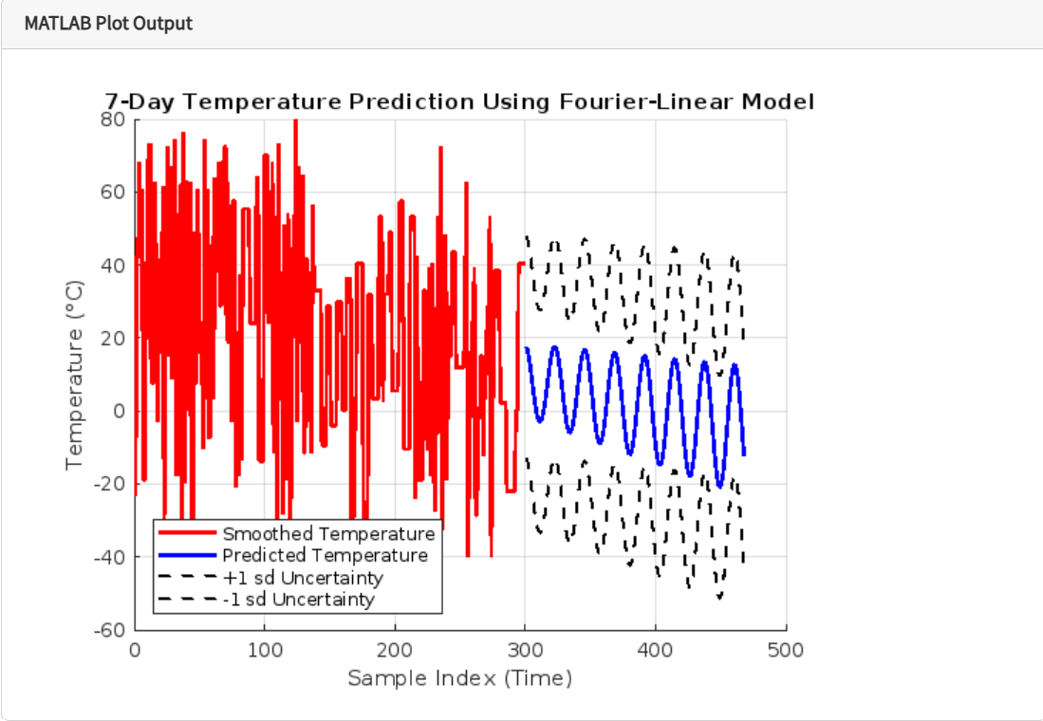
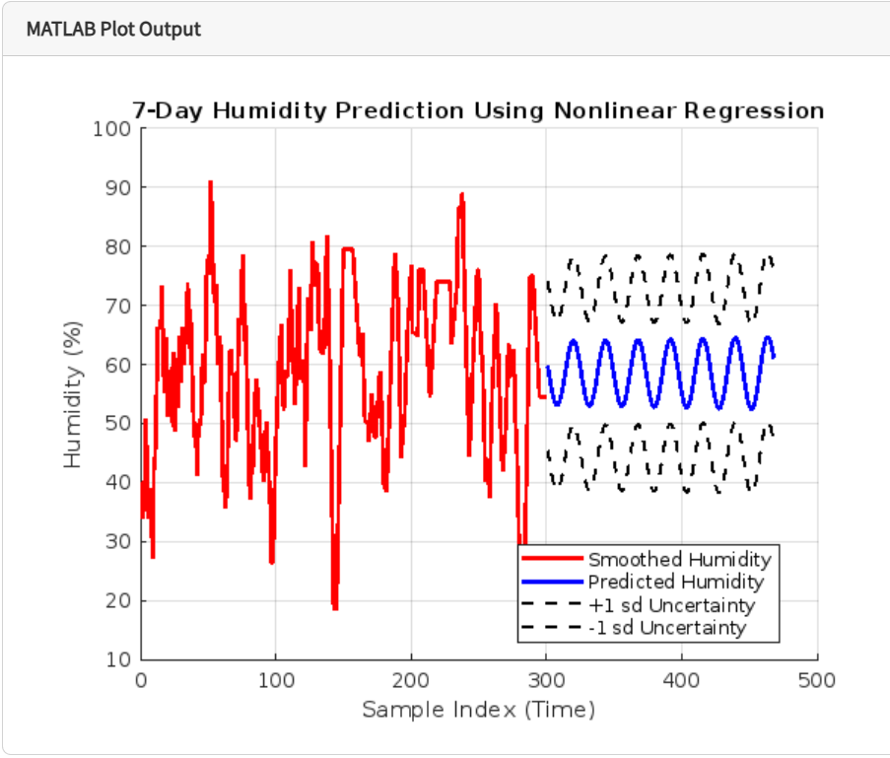
Implementation and Results – Iteration 1
Results
28

Slide 29
Contribution
Team Progress and Movement
Learning Basic Topics about machine learning algorithms
Literature Survey – Base Papers
Implementation in NODE-RED, Wokwi, MQTTX, ML algorithms
Displaying dashboard in NODE-RED and graph and prediction in python.
Taking data points from wokwi and sending that data to thingspeak.
Analysing the data in thingspeak.
Clustering the data points by using K-means algorithm.
Prediction of temperature and Humidity.
Individual Contribution
Key contributions: K. SOWMYA
Literature Survey
Wokwi code, Machine learning algorithms
Key contributions: R. MOKSHITHA
Literature Survey
NODE-RED, Machine learning algorithms, Thingspeak.
Key contributions: M. LOK VIGNESH
Literature Survey
Wokwi code, NODE-RED and MQTTX
Machine learning algorithms

Slide 30
Conclusion & Future Work
Summary and Conclusion
This project successfully developed a real-time health monitoring system for automobiles, integrating IoT, cloud computing, and AI to enhance vehicle safety and predictive maintenance. Using ESP32 and DHT22, data on temperature and humidity was collected and processed efficiently, with Wokwi simulation reducing hardware costs. The system established seamless MQTT communication between Wokwi, Node-RED, and ThingSpeak, enabling real-time data visualization and cloud-based analysis. Advanced statistical methods and machine learning algorithms such as K-Means clustering, GNN, LSTM, ARIMA, and nonlinear regression were applied to detect anomalies and predict future trends. The results demonstrated that LSTM and ARIMA models were the most effective for anomaly detection, while nonlinear regression provided accurate predictions for temperature and humidity changes. By implementing AI-driven predictive maintenance, this system minimizes unexpected failures, reduces maintenance costs, and improves overall vehicle reliability. This project provides a scalable and cost-effective solution for modern vehicle monitoring, paving the way for further advancements in smart transportation and automotive diagnostics.

Slide 31
Conclusion & Future Work
Future Work
Add more sensors for engine diagnostics, vibration monitoring, and fuel efficiency tracking.
Implement edge computing for faster, on-device AI-based anomaly detection without cloud dependency.
Develop a mobile application for real-time vehicle health updates and alerts.
Enhance AI models with deep learning for improved accuracy and predictive capabilities.
Automate maintenance alerts to notify users based on detected anomalies and predicted failures.
Expand cloud capabilities by integrating with advanced platforms like AWS, Azure, or Google Cloud.

Slide 32
THANK YOU
Have a Great Day !

